Slide 1






Dynamic Programming
Bellman’s principal of optimality states that any part of an optimal route is optimal itself
Eg a directed network
Bellman’s principal underpins an algorithm called dynamic programming, which uses the following terminology:
11
The route from S to T is divided into stages, each of which requiring a choice of which route to take.
5
6
8
9
The vertex you are considering at any point is called a state
7
4
12
The arc you select from a state is the action taken
Stage 3
Stage 2
Stage 1
The vertex this leads to is called a destination
If the shortest path from S to T is SADT,
the shortest path from S to D is SAD
The sum of the weight of the arcs used in a sequence of actions is called the value
the shortest path from A to T is ADT

Slide 2
Dynamic Programming
Dynamic programming is an optimisation algorithm that works from the end to the beginning of a problem. It has greater adaptability than algorithms such as Dijkstra, even though it looks more confusing at first!
Stage
Start
Finish
Route so far
Eg find the shortest path from S to T
1
C
T
CT
6
11
D
T
DT
4
5
6
2
A
C
ACT
11+6=17
8
9
A
D
ADT
8+4=12
4
B
C
BCT
9+6=15
7
B
D
BDT
12+4=16
12
3
S
A
SADT
5+12=17
Stage 3
Stage 2
Stage 1
S
B
SBCT
7+15=22
In practice, the table looks slightly different to this, using standard labels for the columns and only working out the best route at the end
The shortest path is SADT
There are 2 routes from A on to T – use the best one (via D)
There are 2 routes from B on to T – use the best one (via C)

Slide 3
Dynamic Programming
Dynamic programming optimises the results (values) obtained from choosing a combination of options (states) by examining, step-by-step (in stages), the effect of possible actions and sometimes what this leads to (destinations).
Eg use dynamic programming to find the longest path from S to T
Stage
State
Action
Value
1
C
CT
6*
11
D
DT
4*
5
6
2
A
AC
11+6=17
*
8
9
AD
8+4=12
B
BC
9+6=15
7
4
BD
12+4=16
*
12
3
S
SA
5+17=22
Stage 3
Stage 2
Stage 1
SB
7+16=23
*
To find the route, work through the table, stage-by-stage from the bottom, using the * to identify best options where necessary:
If a state has more than 1 possible action, * the best one
S
B
D
T
= 23

Slide 4
Dynamic Programming
The method can be adapted to find minimax routes (where the longest arc is as small as possible). Eg planning stops on a long journey, so that the legs of the journey are as short as possible (applied to carriage of freight in industry)
Eg use dynamic programming to find a minimax route from S to T
Stage
State
Action
Value
1
C
CT
6*
11
D
DT
4*
5
6
2
A
AC
max(11,6)=11
8
9
AD
max(8,4)=8
*
B
BC
max(9,6)=9
*
7
4
BD
max(12,4)=12
12
3
S
SA
max(5,8)=8
*
Stage 3
Stage 2
Stage 1
SB
max(7,9)=9
To find the route, work through the table, stage-by-stage from the bottom, using the * to identify best options where necessary:
Record the largest value each time, and * the shorter options
S
A
D
T
= 8

Slide 5
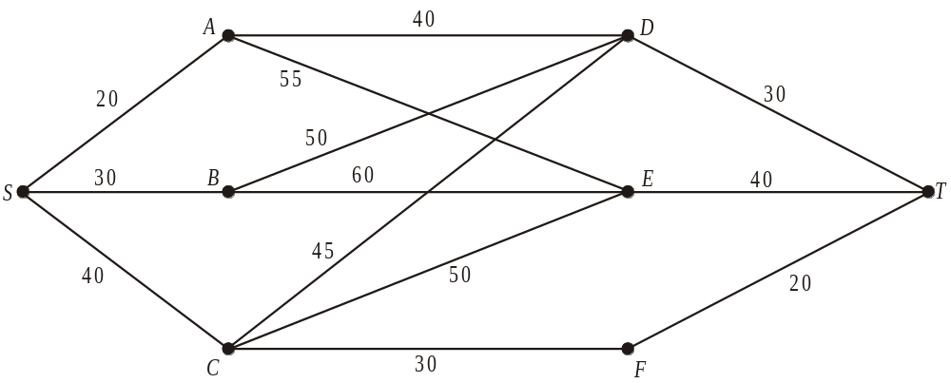
WB23 Find a minimax route through the network shown in the diagram
Stage
Initial State
Action
Final State
Value
1
D
DT
T
30*
E
ET
T
40*
F
FT
T
20*
2
A
AD
D
*
max(40,30) = 40
AE
E
max(55, 40) = 55
B
BD
D
*
max(50,30) = 50
BE
E
max(60,40) = 60
C
CD
D
max(45,30) = 45
CE
E
max(50,40) = 50
CF
F
*
max(30,20) = 30
3
S
SA
A
max(20,40) = 40
*
SB
B
max(30,50) = 50
SC
C
*
max(40,30) = 40
Minimax routes:
SADT
SCFT

Slide 6
Dynamic Programming
The method can be adapted to find maximin routes (where the shortest arc is as large as possible). Eg a company deciding investment options so that its lowest profit each year is as high as possible.
Eg use dynamic programming to find a maximin route from S to T
Stage
State
Action
Value
1
C
CT
6*
11
D
DT
4*
5
6
2
A
AC
min(11,6)=6
*
8
9
AD
min(8,4)=4
B
BC
min(9,6)=6
*
7
4
BD
min(12,4)=4
12
3
S
SA
min(5,6)=5
Stage 3
Stage 2
Stage 1
SB
min(7,6)=6
*
To find the route, work through the table, stage-by-stage from the bottom, using the * to identify best options where necessary:
Record the smallest value each time, and * the bigger options
S
B
C
T
= 6

Slide 7
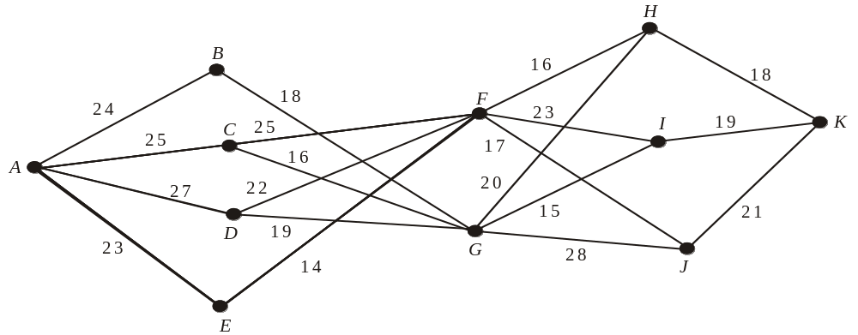
WB22 Find a maximin route through the network shown in the diagram
Stage
State
Action
Value
1
H
HK
18*
I
IK
19*
J
JK
21*
2
F
FH
min(16,18) = 16
FI
*
min(23,19) = 19
FJ
min(17,21) = 17
G
GH
min(20,18) = 18
GI
min(15,21) = 15
GJ
*
min(28,21) = 21
3
B
BG
min(18,21) = 18*
C
CF
*
Maximin routes:
min(25,19) = 19
CG
min(16,21) = 16
D
DF
*
min(22,19) = 19
ACFIK
DG
min(19,21) = 19
*
E
EF
min(14,18) = 14*
4
A
AB
min(24,18) = 18
ADFIK
AC
*
min(25,19) = 19
AD
*
min(27,19) = 19
ADGJK
AE
min(23,14) = 14

Slide 8
Exercise 7A, Question 1
 |  |  | Value
Stage | State | Action | Longest route | Shortest route | Minimax route | Maximin route

Slide 9
Dynamic Programming in context
The true power of dynamic programming is in its ability to be adapted to a range of problems in context, and where the solutions are not available by other algorithms.
Eg a travelling salesman deciding on a route that maximises total profit
Eg a manufacturer deciding on a production schedule that minimises the total spent
Eg a company deciding on a marketing or expansion strategy that minimises the maximum annual outlay
The terms ‘stage’, ‘state’, ‘action’ and ‘destination’ can have varying meanings depending on the context being considered.

Slide 10
WB20 Kris produces custom made racing cycles.
She can produce up to four cycles each month, but if she wishes to produce more than three in any one month she has to hire additional help at a cost of £350 for that month.
In any month when cycles are produced, the overhead costs are £200.
A maximum of 3 cycles can be held in stock in any one month, at a cost of £40 per cycle per month.
Cycles must be delivered at the end of the month.
The order book for cycles is
Month | August | September | October | November
No. cycles required | 3 | 3 | 5 | 2
There is no stock at the beginning of August and Kris plans to have no stock after the November delivery.

Slide 11
(b) Disregarding the cost of parts and Kris’ time, use dynamic programming to determine the production schedule which minimises the costs,
No. in stock
No. to make
No. to store
Stage
Demand
State
Action
Destination
Value
1
(Nov)
2
0
2
0
200*
1
1
0
200 + 40 =240*
2
(Oct)
5
1
4
0
200 + 350 + 40 + 200 = 790*
2
3
0
200 + 2 x 40 + 200 = 480
*
4
1
200 + 350 + 2 x 40 + 240 = 870
3
(Sep)
3
0
4
1
200 + 350 + 790 = 1340*
1
3
1
200 + 40 + 790 = 1030
*
4
2
200 + 350 + 40 + 480 = 1070
0
3
0
200 + 1340 = 1540
4
(Aug)
3
*
4
1
200 + 350 + 1030 = 1580
Month | August | September | October | November
Number of cycles to be made
The maximum Kris can produce per month is 4, so she must have at least 1 in stock at the start of November to meet the month’s demand
Overhead costs = £200
Additional help = £350
Storage = £40 per cycle
If Kris has 2 in stock, she could produce 4 and keep 1 to meet November’s demand
Kris needs to store at least 1 bike from September for October
Kris plans to have no stock after the November delivery.
Kris stored at most 2 bikes from August & September
Kris stored at most 1 bike from August to October
Kris has no bikes stored from before August
Kris stored at most 1 bike from August
3
4
4
2
Month | August | September | October | November
No. cycles required | 3 | 3 | 5 | 2
The fixed cost of parts is £600 per cycle and of Kris’ time is £500 per month. She sells the cycles for £2000 each.
(c) Determine her total profit for the four month period.
Total spending = 4 x 500 +13 x 600 + 1540 = £11340
Total income = 13 x 2000 = £26000
Total profit = £14660

Slide 12
WB21 Joan sells ice cream. She needs to decide which three shows to visit over a three-week period in the summer. She starts the three-week period at home and finishes at home. She will spend one week at each of the three shows she chooses travelling directly from one show to the next.
Table 1 gives the week in which each show is held. Table 2 gives the expected profits from visiting each show. Table 3 gives the cost of travel between shows.
Week | 1 | 2 | 3
Shows | A, B, C | D, E | F, G, H
Table 1
Show | A | B | C | D | E | F | G | H
Expected Profit (£) | 900 | 800 | 1000 | 1500 | 1300 | 500 | 700 | 600
Table 2
Travel costs (£) | A | B | C | D | E | F | G | H
Home | 70 | 80 | 150 |  |  | 80 | 90 | 70
A |  |  |  | 180 | 150
B |  |  |  | 140 | 120
C |  |  |  | 200 | 210
D |  |  |  |  |  | 200 | 160 | 120
E |  |  |  |  |  | 170 | 100 | 110
Table 3

Slide 13
Use dynamic programming to find a schedule that maximises the total expected profit, taking into account the travel costs
Show attended
Next journey
Stage
State
Action
Value
1
F
F - Home
500 – 80 = 420*
G
G - Home
700 – 90 = 610*
H
H - Home
600 – 70 = 530*
2
D
DF
1500 – 200 + 420 = 1720
DG
1500 – 160 + 610 = 1950
*
DH
1500 – 120 + 530 = 1910
E
EF
1300 – 170 + 420 = 1550
EG
1300 – 100 + 610 = 1810
*
EH
1300 – 110 + 530 = 1720
3
A
AD
900 – 180 + 1950 = 2670
*
AE
900 – 150 + 1810 = 2560
B
BD
800 – 140 + 1950 = 2610
*
BE
800 – 120 + 1810 = 2490
C
CD
*
1000 – 200 + 1950 = 2750
CE
1000 – 210 + 1810 = 2600
4
Home
Home - A
-70 + 2670 = 2600
*
Home - B
-80 + 2610 = 2530
Home - C
-150 + 2750 = 2600
*
Travel costs (£) | D | E
A | 180 | 150
B | 140 | 120
C | 200 | 210
Week | 1 | 2 | 3
Shows | A, B, C | D, E | F, G, H
Week | 1 | 2 | 3
Show
Travel costs (£) | F | G | H
D | 200 | 160 | 120
E | 170 | 100 | 110
Travel costs (£) | F | G | H
Home | 80 | 90 | 70
Show | A | B | C
Expected Profit (£) | 900 | 800 | 1000
Travel costs (£) | A | B | C
Home | 70 | 80 | 150
Show | D | E
Expected Profit (£) | 1500 | 1300
Show | F | G | H
Expected Profit (£) | 500 | 700 | 600
A
or C
D
G
Total profit = £2600

Slide 14
Eg A builder has purchased a site and will build three houses A,B,C at a rate of one a year.
Already built | A | B | C
Nothing | 70 | 80 | 75
A | - | 90 | 80
B | 90 | - | 95
C | 95 | 100 | -
A and B | - | - | 105
A and C | - | 110 | -
B and C | 115 | - | -
As each house is built it causes access problems for future work, causing construction costs to rise.
The builder’s estimates of costs are shown in the table below, in £1000s
For tax reasons the builder wants to make the least annual cost as large as possible
Stage
State
Action
Destination
Value
1
AB
C
ABC
105*
AC
B
ABC
110*
BC
A
ABC
115*
2
A
B
AB
*
min(90,105) = 90
C
AC
min(80,110) = 80
B
A
AB
min(90,105) = 90
C
BC
*
min(95,115) = 95
C
A
AC
min(95,110) = 95
B
BC
*
min(100,115) = 100
3
None
A
A
min(70,90) = 70
B
B
*
min(80,95) = 80
C
C
min(75,100) = 75
Optimal order is BCA with maximum annual cost £80000

Slide 15
Ex 7C, Q1 - minimax
Costs of introducing resorts A, B and C to a holiday catalogue, at rate of 1 per year
Resorts listed | A | B | C
None | 60 | 60 | 55
A | - | 50 | 60
B | 40 | - | 55
C | 35 | 50 | -
A and B | - | - | 50
A and C | - | 45 | -
B and C | 30 | - | -
Year
Resorts listed
Resort added
Stage
State
Action
Value
1
(year 3)
A,B
C
50*
A,C
B
45*
B,C
A
30*
2
(year 2)
A
B
*
max(50,50) = 50
C
max(60,45) = 60
B
A
*
max(40,50) = 50
C
max(55,30) = 55
C
A
*
max(35,45) = 45
B
max(50,30) = 50
1
(year 1)
None
A
max(60,50) = 60
B
max(60,50) = 60
C
*
max(55,45) = 55
Year | 1 | 2 | 3
Resort added | C | A | B
Schedule:
Maximum annual cost £5500

